Slide 1
Satellite Applications in the Monitoring and Modeling of Atmospheric Aerosols
Yang Liu, Ph.D.
11/18/2014
2nd Suomi NPP Applications Workshop Huntsville, Alabama

Slide 2
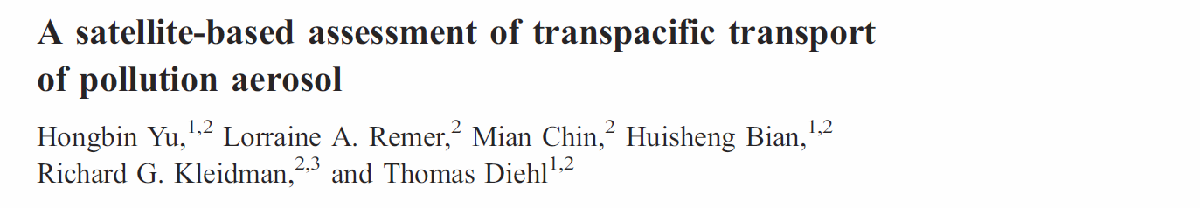
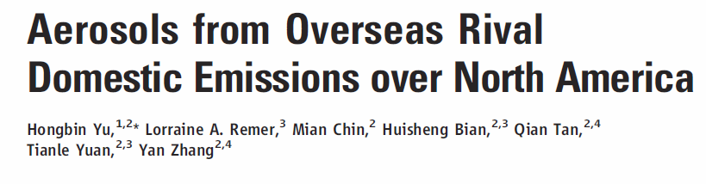
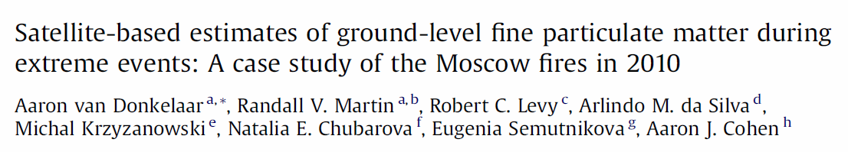
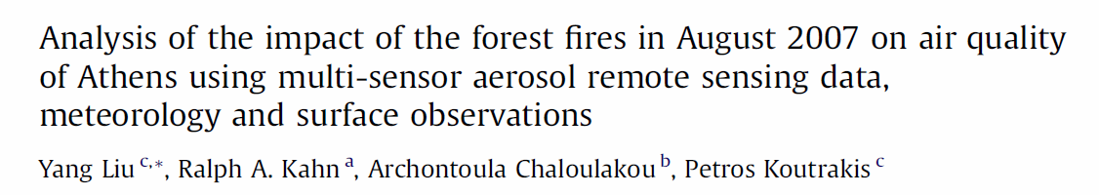
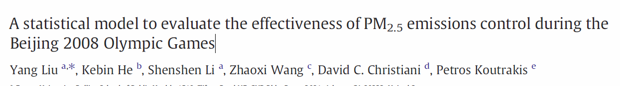
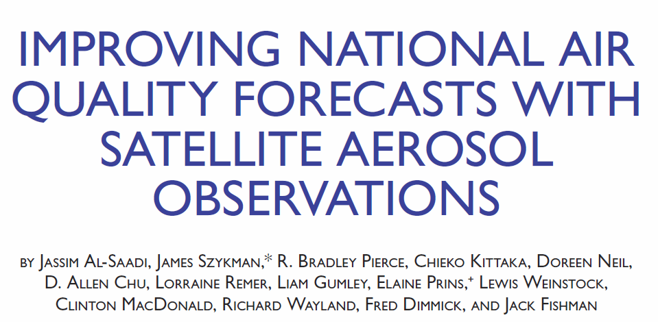
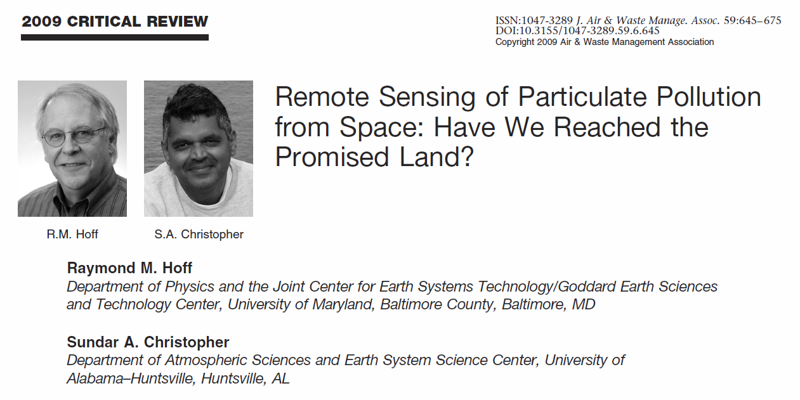
Satellite Applications in Aerosol Monitoring

Slide 3
Satellite-retrieved Aerosol Parameters
Aerosol optical depth (AOD or τ)
Angstrom exponent (α)
Single scattering albedo (ω)
Particle sphericity (MISR)
Absorbing AOD (OMI)
Aerosol air mass types (MISR, OMI)
Aerosol vertical profiles (CALIPSO, MISR)
Primary application target: PM_{2.5} (criterion air pollutant linked to > 3 M premature deaths per year in the world

Slide 4
Instruments and AOD Products
 | MISR | MODIS | MAIAC | VIIRS
Platform | Terra | Terra / Aqua | Terra / Aqua | Suomi NPP
Availability | 2000 – | 2000 / 2002 – | 2000 / 2002 – | Late 2011 –
Overpass time | ~10:30 am | ~10:30 am / 1:30 pm | ~10:30 am / 1:30 pm | ~1:30 pm
Resolution | 4.4 km | 10 km (DT, DB) and 3 km (DT) | 1 km (NA only) | 6 km EDR, 0.75 km IP
Frequency | 7-9 days | Twice a day | Twice a day | daily
Older instruments: AVHRR, SeaWiFS
GEO platforms: GOES, future GOES-R & TEMPO

Slide 5

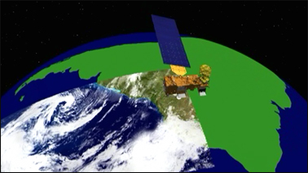
AOD and PM_{2.5} are different
AOD – Column integrated value, optical measurement of ambient particle loading.
Relative accuracy: ~15%
PM_{2.5} – Ground level, dry mass concentration with a clear size cut
Relative accuracy: < 5%
Accuracy, consistency, and coverage are key!

Slide 6
From AOD to PM_{2.5}
ρ – particle density
Q – extinction coefficient
r_{e} – effective radius
f_{PBL} – % AOD in PBL
H_{PBL} – mixing height
Composition
Size distribution
Vertical profile
AOD-PM_{2.5} relationship varies in space and time

Slide 7
Summary of quantitative methods
Statistical models
  Correlation (e.g., Wang and Christopher, 2003, Engel-Cox et al. 2004)
  Multiple linear regression w/ effect modifiers (e.g., Liu et al. 2005)
  Geostatistical models (e.g., Al-Hamdan et al. 2009)
  Linear mixed effects models (e.g., Lee et al. 2011)
  Geographically weighted regression (e.g., Hu et al. 2013)
  Generalized additive models (e.g., Liu et al. 2009, Strawa et al. 2014)
  Hierarchical models (e.g., Kloog et al. 2012, Hu et al. 2014)
  Artificial neural network (e.g., Gupta et al. 2009, Yao and Lu. 2014)
  Bayesian downscaler models (e.g., Chang et al. 2013)
Fusion with model simulations (e.g., Liu et al. 2004, 2009, van Donkelaar et al. 2010, Boys et al. 2014)
Data assimilation
  Improving chemical model simulations with satellite data (e.g., Hyer et al. 2011, Wang et al. 2013)
Notes:
Most of the model development has been driven by AQ and PH needs.

Slide 8
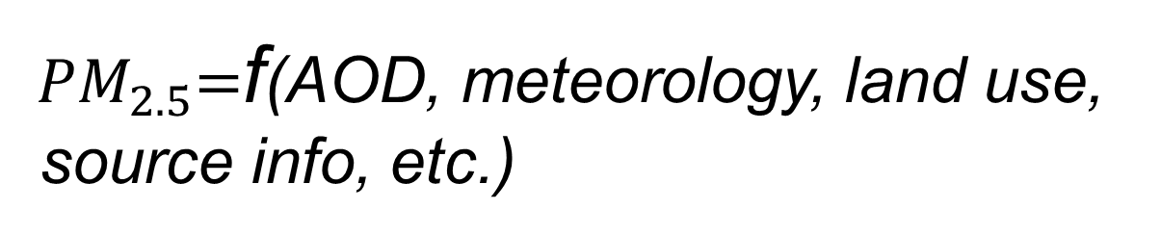
Statistical Models
${ PM}_{2.5}=$f(AOD, meteorology, land use,
source info, etc.)
Ground-data calibration → high accuracy (R² > 0.8) and low bias (< 10%) at daily level
Versatile structures to account for nonlinear AOD-PM_{2.5} relationship
Can’t be used in regions w/o ground data support
Used to predict daily PM_{2.5} in retrospective health effects studies in NA

Slide 9
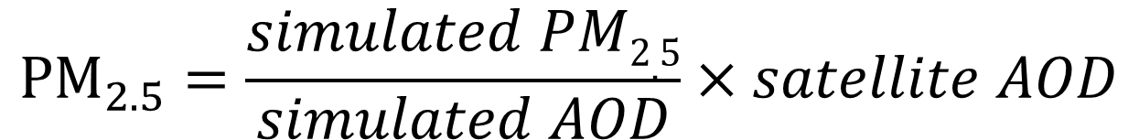
Data Fusion (aka Scaling) Method
$${PM}_{2.5}=\frac{simulated PM2.5}{simulated AOD}×satellite AOD$$
Straightforward method
No ground data required in model development
No ground data calibration – larger prediction error
Used to provide annual estimates in regions w/o or w/ sparse ground PM_{2.5} data

Slide 10
Needs for Satellite Data / Models
For research
  Multi-scale PM_{2.5} modeling
  CTM cal / val
  Satellite-driven health effect studies
  Higher resolution, more coverage and better accuracy
For AQ management
  Accepted in EPA exceptional event justification
  Might go into SIPs
  Must deal with missing data
  Requires consistent data stream for compliance
For both: error characterization and propagation
What do we do after a satellite is gone?
Need a flexible data integration system (Bayesian model? Assimilation system?)

Slide 11

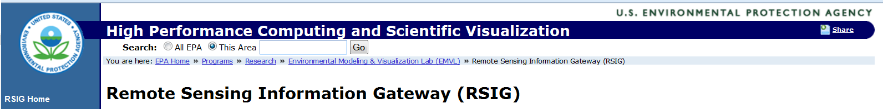
Examples of Applications
Model developed, predictions delivered and online, papers published, presentations / webinars given
Need time to build capacity in Tracking and its partner organizations
With EPA and NASA backing, publishing subsetted RS data mainly for modelers
Designed for experienced research-oriented users
Need to be more “quick and easy” to attract less experienced users

Slide 12

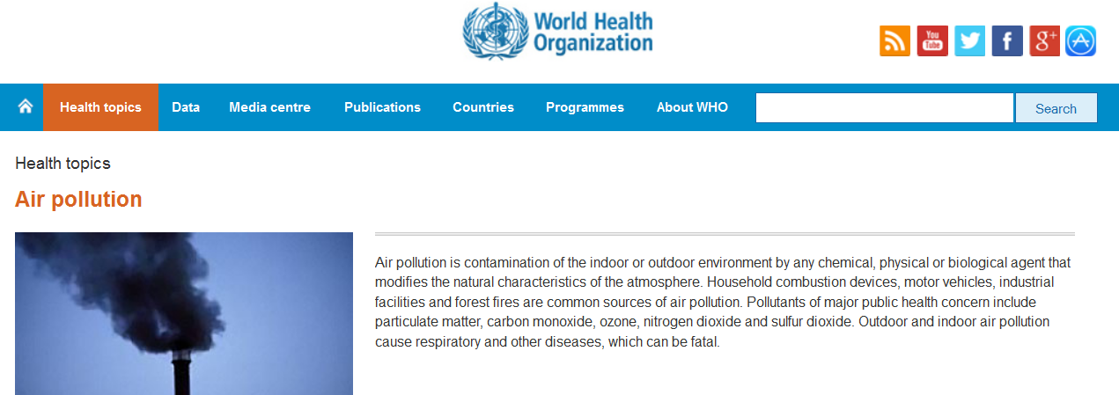
Potential Applications
MODIS/MISR data used to help predict global PM_{2.5} concentrations
NASA is not involved in these high profile efforts

Slide 13
Extra slides

Slide 14
Evaluation of VIIRS, GOCI, and MODIS C6 3 km AOD over East Asia
Qingyang Xiao, Shenshen Li, Jhoon Kim, Brent Holben, Yang Liu
10 km satellite product is insufficient to resolve small-scale aerosol variability
Several emerging products have higher resolution
Research question: Can these new products provide accurate AOD retrievals in urban areas at higher resolution?

Slide 15
Study Area – DRAGON East Asia

Slide 16
Satellite and Ground Data
 |  | Temporal Comparison | Spatial Comparison
Beijing | Dataset | AERONET | Microtops II
 | Available Time | Jan 2012-Jun 2013 | Jan 2012- Jun 2013
 | Including Criteria | Level 2.0 if available | Median/Std. Dev. <2
DRAGON East Asia Domain | Data Set | AERONET | DRAGON
 | Available Time | Jan 2012-Jun 2013 | Feb 2012-May 2012
 | Including Criteria | Level 2.0 | Level 2.0
Dataset | Available Time | Resolution | Coverage
VIIRS EDR | 05/2012-06/2013 | 6 km, daily | Global
VIIRS IP | 05/2012-06/2013 | 0.75 km, daily | Global
GOCI | 01/2012-12/2012 | 6 km, 8 hourly obs. per day | East Asia
MODIS C6 3 km | 01/2012-06/2013 | 3 km, daily | Global

Slide 17
Comparison of Data Distribution
Satellite AOD retrievals tend to overestimate
VIIRS IP and MODIS 3 km appear bimodal

Slide 18
Bias Evaluation
VIIRS EDR has high correlation but a small bias at AOD <0.2
VIIRS IP has a positive bias & is noisy
MODIS C6 3km has the highest correlation but a positive bias
GOCI has the lowest bias, most data, but only regional coverage
No one product is perfect, need to consider integration

